Slide 1
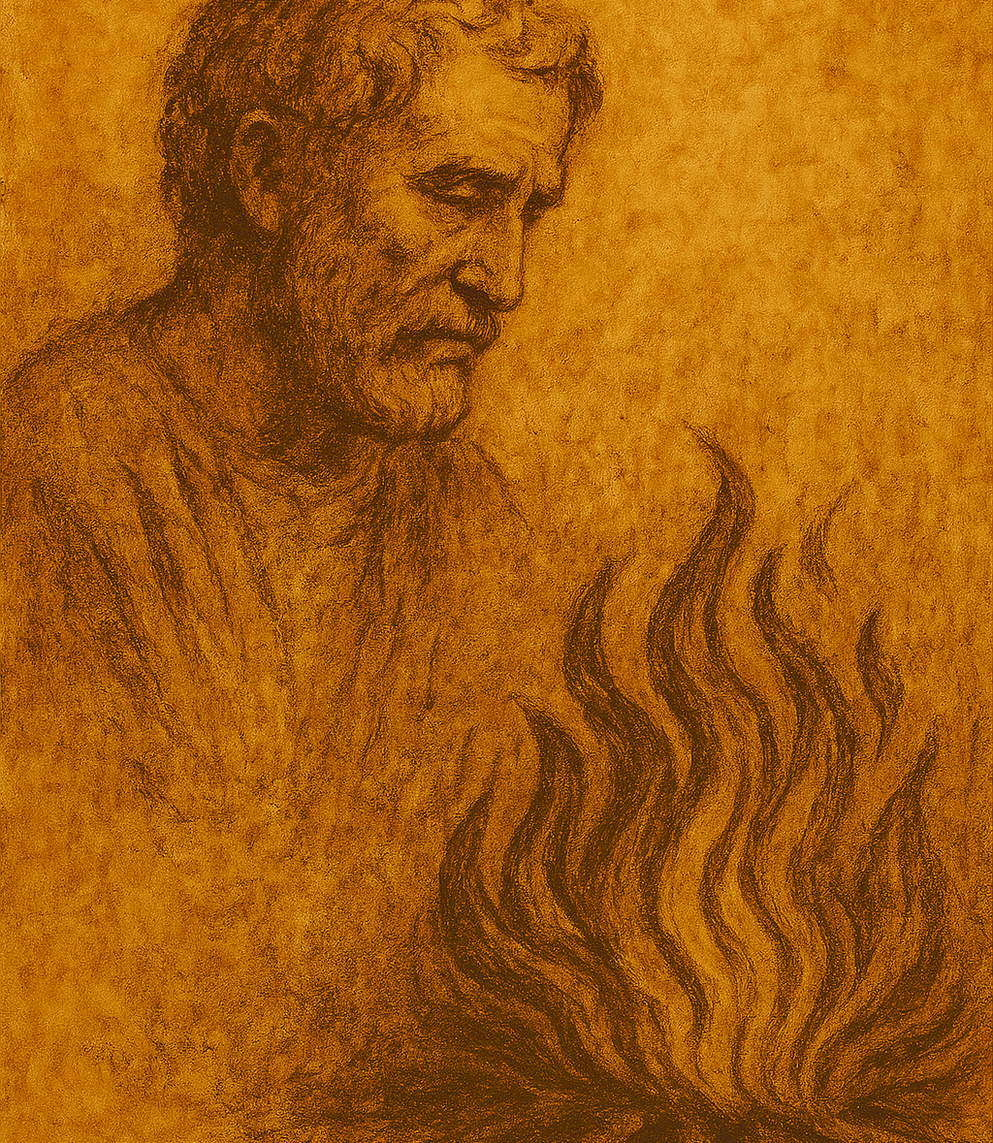
It’s Never Too Late for Grace: Peter’s Journey
Lk 5:1-11; 9:18-20; 22:54-62; Jn 21:15-19

Slide 2


Slide 3


Slide 4
Calling: Luke 5:1-11
5 One day as Jesus was preaching on the shore of the Sea of Galilee, great crowds pressed in on him to listen to the word of God. ² He noticed two empty boats at the water’s edge, for the fishermen had left them and were washing their nets. ³ Stepping into one of the boats, Jesus asked Simon, its owner, to push it out into the water. So, he sat in the boat and taught the crowds from there.
⁴ When he had finished speaking, he said to Simon, “Now go out where it is deeper, and let down your nets to catch some fish.”
⁵ “Master,” Simon replied, “we worked hard all last night and didn’t catch a thing. But if you say so, I’ll let the nets down again.”

Slide 5
Calling: Luke 5:1-11
⁶ And this time their nets were so full of fish they began to tear! ⁷ A shout for help brought their partners in the other boat, and soon both boats were filled with fish and on the verge of sinking.
⁸ When Simon Peter realized what had happened, he fell to his knees before Jesus and said, “Oh, Lord, please leave me—I’m such a sinful man.” ⁹ For he was awestruck by the number of fish they had caught, as were the others with him. ¹⁰ His partners, James and John, the sons of Zebedee, were also amazed.
Jesus replied to Simon, “Don’t be afraid! From now on you’ll be fishing for people!” ¹¹ And as soon as they landed, they left everything and followed Jesus.

Slide 6
Calling: Luke 5:1-11
Peter wasn’t kept away from following Jesus because of his limitations.

Slide 7
Confession: Luke 9:18-20
¹⁸ One day Jesus left the crowds to pray alone. Only his disciples were with him, and he asked them, “Who do people say I am?”
¹⁹ “Well,” they replied, “some say John the Baptist, some say Elijah, and others say you are one of the other ancient prophets risen from the dead.”
²⁰ Then he asked them, “But who do you say I am?”
Peter replied, “You are the Messiah sent from God!”

Slide 8
Confession: Luke 9:18-20
Even the limited confession that Jesus is from God is an important step in the journey of faith.

Slide 9
Collapse: Luke 22:54-62
⁵⁴ So they arrested him and led him to the high priest’s home. And Peter followed at a distance. ⁵⁵ The guards lit a fire in the middle of the courtyard and sat around it, and Peter joined them there. ⁵⁶ A servant girl noticed him in the firelight and began staring at him. Finally, she said, “This man was one of Jesus’ followers!”
⁵⁷ But Peter denied it. “Woman,” he said, “I don’t even know him!”
⁵⁸ After a while someone else looked at him and said, “You must be one of them!”
“No, man, I’m not!” Peter retorted.

Slide 10
Collapse: Luke 22:54-62
⁵⁹ About an hour later someone else insisted, “This must be one of them, because he is a Galilean, too.”
⁶⁰ But Peter said, “Man, I don’t know what you are talking about.” And immediately, while he was still speaking, the rooster crowed.
⁶¹ At that moment the Lord turned and looked at Peter. Suddenly, the Lord’s words flashed through Peter’s mind: “Before the rooster crows tomorrow morning, you will deny three times that you even know me.” ⁶² And Peter left the courtyard, weeping bitterly.

Slide 11
Collapse: Luke 22:54-62
Sometimes our faith failures are not the end but the beginning of a new story of God’s grace.

Slide 12
Comfort: John 21:15-19
¹⁵ After breakfast Jesus asked Simon Peter, “Simon son of John, do you love me more than these?”
“Yes, Lord,” Peter replied, “you know I love you.”
“Then feed my lambs,” Jesus told him.
¹⁶ Jesus repeated the question: “Simon son of John, do you love me?”
“Yes, Lord,” Peter said, “you know I love you.”
“Then take care of my sheep,” Jesus said.
¹⁷ A third time he asked him, “Simon son of John, do you love me?”
Peter was hurt that Jesus asked the question a third time. He said, “Lord, you know everything. You know that I love you.”
Jesus said, “Then feed my sheep.

Slide 13
Comfort: John 21:15-19
¹⁸ “I tell you the truth, when you were young, you were able to do as you liked; you dressed yourself and went wherever you wanted to go. But when you are old, you will stretch out your hands, and others will dress you and take you where you don’t want to go.” ¹⁹ Jesus said this to let him know by what kind of death he would glorify God. Then Jesus told him, “Follow me.”

Slide 14
Comfort: John 21:15-19
Faith is a matter of answering Jesus’ question, “Do you love me?”

