Slide 1
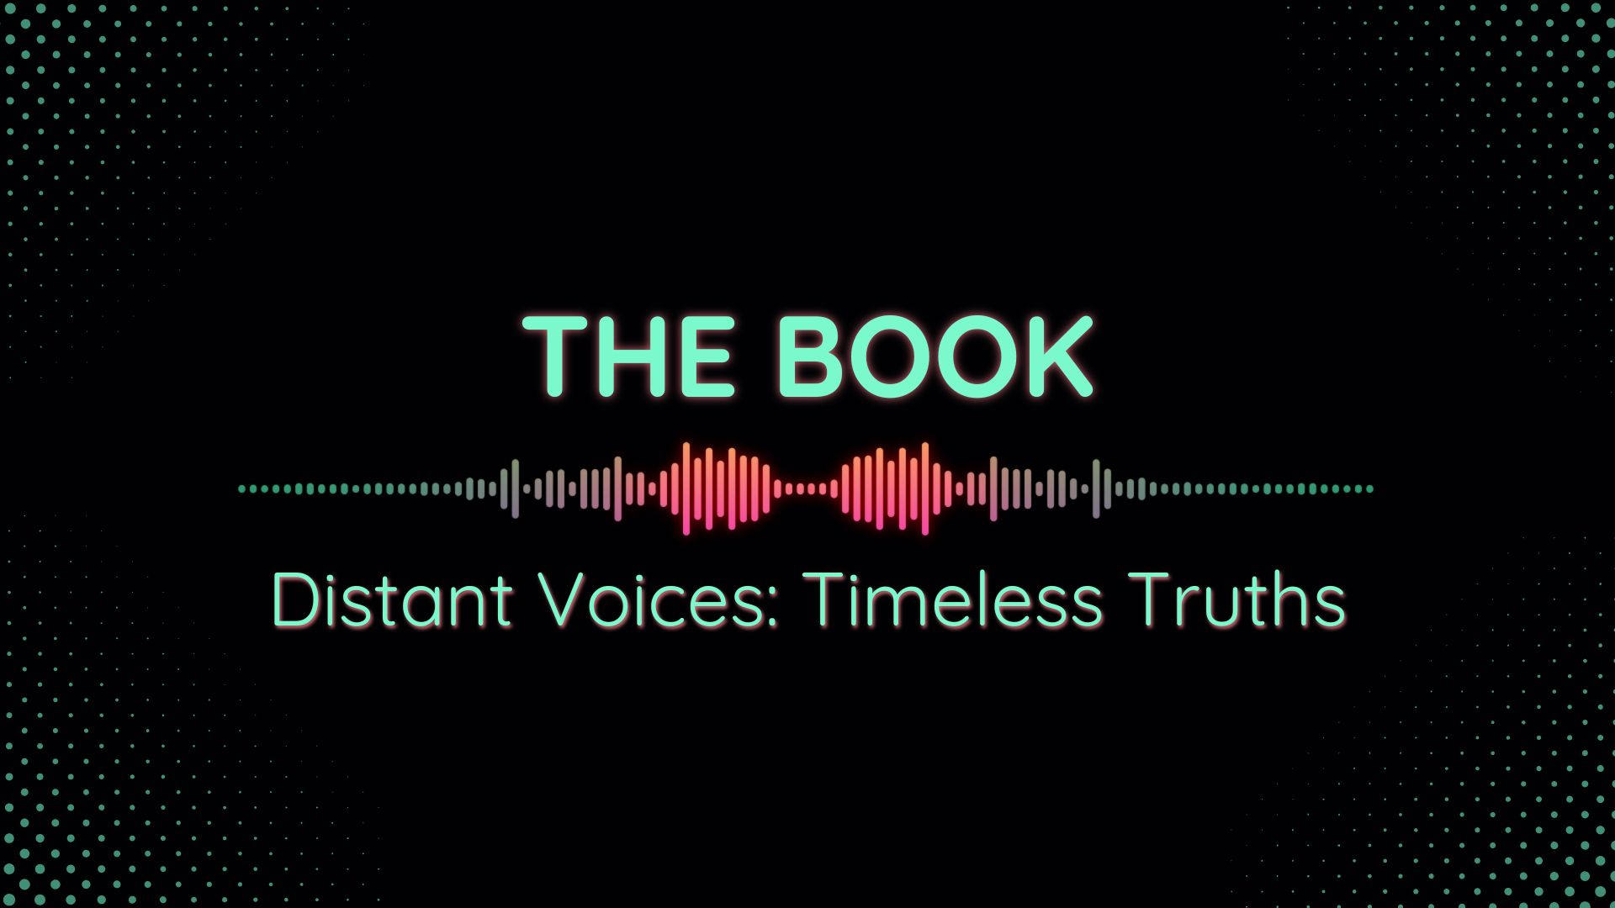

Slide 2
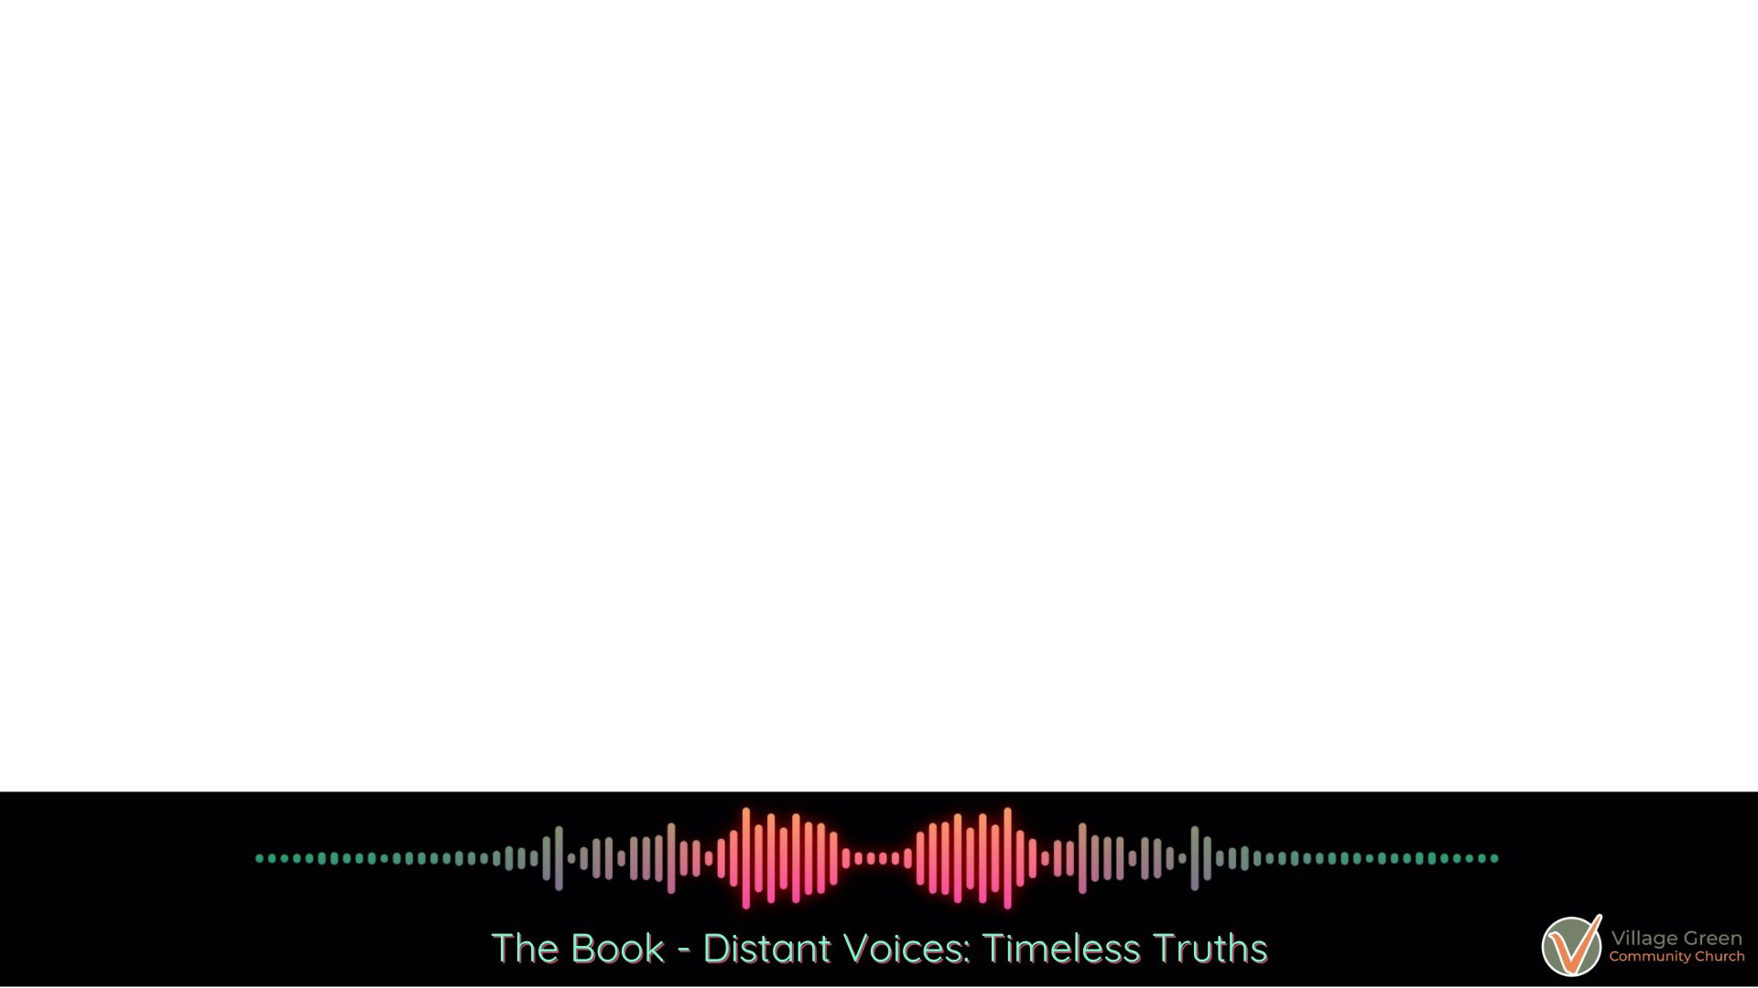
¹⁹ Because of that experience, we have even greater confidence in the message proclaimed by the prophets. You must pay close attention to what they wrote, for their words are like a lamp shining in a dark place—until the Day dawns, and Christ the Morning Star shines in your hearts. ²⁰ Above all, you must realize that no prophecy in Scripture ever came from the prophet’s own understanding, ²¹ or from human initiative. No, those prophets were moved by the Holy Spirit, and they spoke from God.
2 Peter 1:19-21 NLT

Slide 3
Isaiah Jeremiah Lamentations Ezekiel Daniel
Major Prophets
Minor Prophets
Hosea
Joel
Amos
Obadiah
Jonah
Micah
Nahum
Habakkuk
Zephaniah
Haggai
Zechariah
Malachi

Slide 4
Isaiah Jeremiah Lamentations Ezekiel *Daniel
Major Prophets
Minor Prophets
Hosea
Joel
Amos
Obadiah
Jonah
Micah
Nahum
Habakkuk
Zephaniah
Haggai
Zechariah
Malachi
Major and Minor simply denote the length of each prophet’s writing

Slide 5
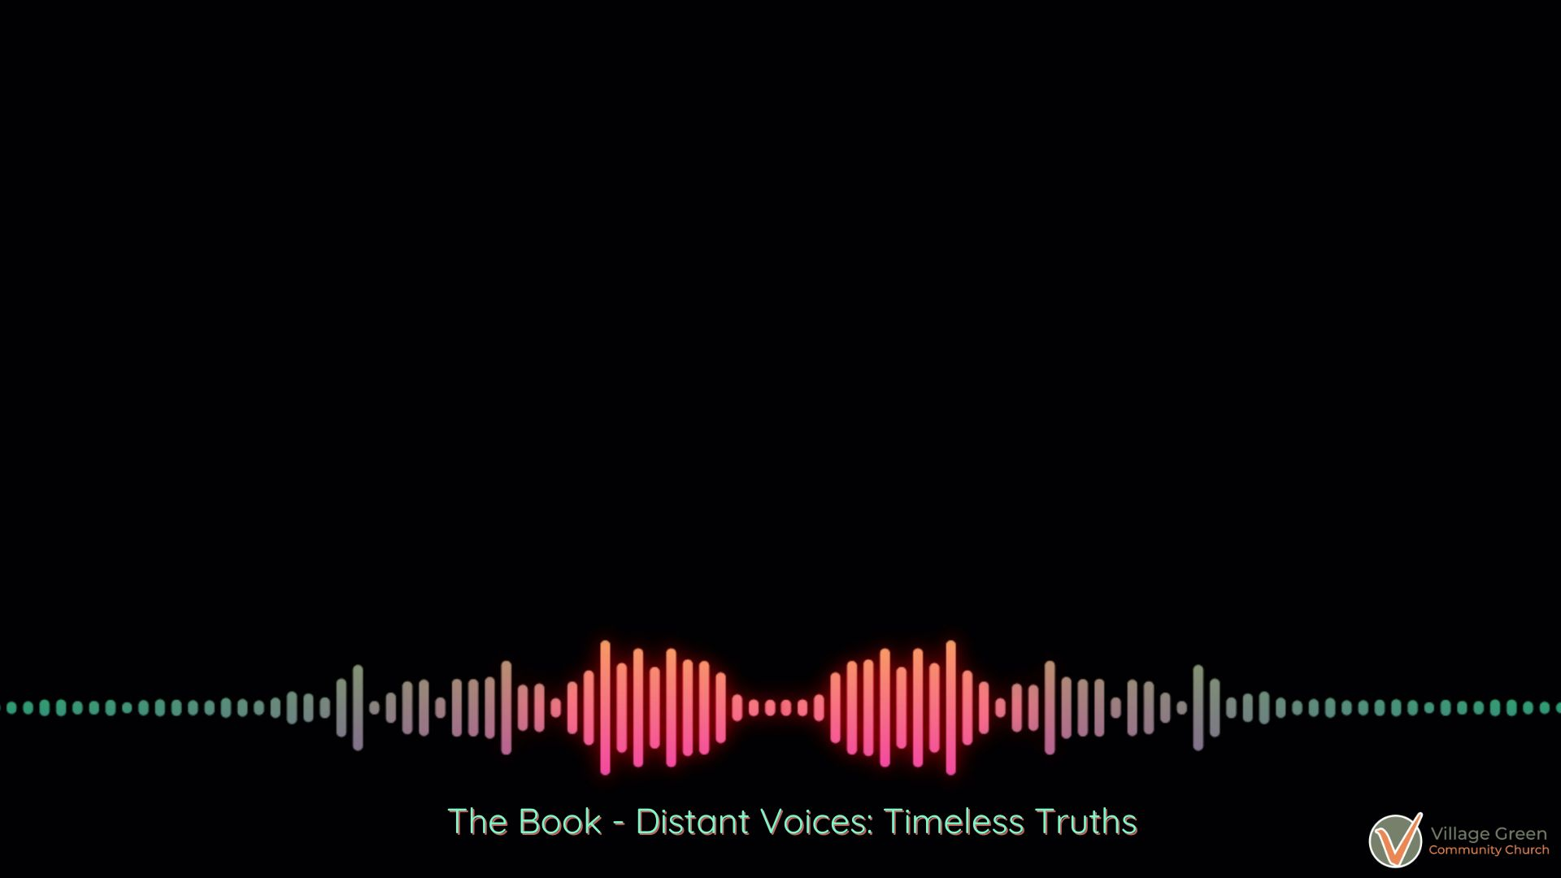
The Prophets: Revelation
The Christian Faith is rooted in God’s revelation to the Hebrew people.

Slide 6
The Prophets: Revelation
Revelation is a movement of the Holy Spirit.

Slide 7
The Prophets: The Transfiguration
God appointed Jesus to carry out God’s reign.

Slide 8
The Prophets: Key Takeaways
You cannot separate biblical prophets from the covenant God made with Israel

Slide 9
The Prophets – Key Takeaways
You cannot separate biblical prophets from the covenant God made with Israel
Biblical prophets were essentially covenant lawyers or police officers.

Slide 10
The Prophets: Key Themes

Slide 11
The Prophets: Key Themes
Worship

Slide 12
The Prophets: Key Themes
Worship
Justice

Slide 13
The Prophets: Key Themes
Worship
Justice
Mercy

Slide 14
The Prophets: Key Themes
Worship
Justice
Mercy

Slide 15
The Prophets: Key Themes
Worship
Justice
Mercy
The Day of the Lord

Slide 16
The Prophets: Political Mandate

Slide 17
The Prophets: Political Mandate
The Church is set apart by its exclusive worship of God and caring for the weak. The Church is called to challenge any power that threatens these things.

Slide 18
¹ Long ago God spoke many times and in many ways to our ancestors through the prophets. ² And now in these final days, he has spoken to us through his Son. God promised everything to the Son as an inheritance, and through the Son he created the universe.
Hebrews 1:1-2 NLT

